Slide 1
BROWSER
SERVER
HTTP + URL
NAVIGATION
HTML PAGES
CSS
HTML + CSS
HTTP + URL
HTML + CSS
Page
Reload!

Slide 2
BROWSER
SERVER
HTTP + URL
NAVIGATION
Server PAGES
CSS
HTML + CSS + JS
AJAX - HTTP + URL
JS
Partial
Page
Reload!
PARTIAL HTML
ID
<table>
<thead>
<tr>
<th>ID</th>
</tr>
</thead>
<tbody>
<tr>
<td>1</td>
</tr>
</tbody>
</table>
ASP
ASP .Net
JSP
PHP
Ruby
ASP .Net MVC
Spring MVC
Ruby On Rails
1
DB
Vanilla JS, jQuery

Slide 3
SPA – Single Page Application
SERVER
SERVER PAGES
CSS
BROWSER
HTTP + URL
NAVIGATION
JS
HTML + CSS + JS
ASP
ASP .Net
JSP
PHP
Ruby
ASP .Net MVC
Spring MVC
Ruby On Rails
<table>
<thead>
<tr>
<th>ID</th>
</tr>
</thead>
<tbody>
<tr>
<td>1</td>
</tr>
</tbody>
</table>
SERVER
AJAX - HTTP + URL
RESTful API
ASP .Net Web API
JWS
Express JS
Python
DB
JSON to HTML on Client Side
JSON
{
“id”:1
}
Knockout, Backbone JS, Angular 1.x
Angular 2.x, React JS, Vue JS

Slide 4
SPA – Single Page Application
SERVER
SERVER PAGES
CSS
BROWSER
HTTP + URL
NAVIGATION
JS
HTML + CSS + JS
ASP
ASP .Net
JSP
PHP
Ruby
ASP .Net MVC
Spring MVC
Ruby On Rails
<table>
<thead>
<tr>
<th>ID</th>
</tr>
</thead>
<tbody>
<tr>
<td>1</td>
</tr>
</tbody>
</table>
Account
Service
AJAX - HTTP + URL
API GATEWAY
JSON
{
“id”:1
}
Inventory
Service
JSON to HTML on Client Side
Knockout, Backbone JS, Angular 1.x
Angular 2.x, React JS, Vue JS
Shipping
Service

Slide 5
Library vs Framework
Library | Framework
Collection of API’s, targeted to do one specific task | Collection of API’s, targeted for application creation. FW is a piece of code that dictates the architecture of your project.
You are in Full control when you call a method from a library and the control is then returned. | The code never calls into a FW, instead the FW uses your code. We can only follow a FW.
It can be integrated seamlessly into an existing project. | FW cannot be integrated, we have to re-write the code.
jQuery – DOM Manipulation & Ajax Moment.js – Date & Time D3.js – Data Visualization React JS – UI Component | Angular Vue JS

Slide 6

JavaScript Full Stack Application
 | Database | Application FW / API FW | Client Side | Hosting / Server
MEAN | MongoDB | Express JS | Angular | Node
MERN | MongoDB | Express JS | React JS | Node
MEVN | MongoDB | Express JS | Vue JS | Node

Slide 7
0
+
-
0
+
-
domHandler
Counter
{
count: 0,
next: fn() { },
prev: fn() { }
}
<Counter />
<Counter />
<Counter />

Slide 8
Desktop Application
(Cross Platform)
ELECTRON JS
BROWSER (Client Side)
REACTDOM
REACTJS
REACT COMPONENT
VIEW (UI) – JSX*
STYLE (CSS) – JSX / CSS
DATA (Inside) – State
DATA (Outside) – Props
BEHAVIOR – Methods
Mobile Application
REACTNATIVE
Node JS App (Server Side)
REACTDOMSERVER

Slide 9
Composite UI Pattern
ADVER.
NAVIGATION
SIDE NAVIGATION
LIST AREA
DETAILS AREA
STATUS

Slide 10
Manual Configuration
NodeJS
Webpack
Webpack Plugins
Webpack Loaders
Babel
Jest & Enzyme for Testing
REACT CLIENT SIDE
BUILD
ES 2015 +
(Multiple Files)
Babel + Preset (React)
Preset (Env) +
Polyfill (core-js)
react-scripts
WEBPACK-DEV-
SERVER
ES5 / Browser Compatible
(Multiple Files)
Auto Configuration
create-react-app
WEBPACK
CLI
Bundling
(Webpack)
BROWSER
WEBPACK
ES5 (Single File)
Local
HTTP Server
HTML PAGE
Deploy
Inject Bundles

Slide 11
Installation
Node JS (LTS Version) - https://nodejs.org/en/
Visual Studio Code (Latest) - https://code.visualstudio.com/download
Visual Studio Code Extensions
AutoFileName
CSS Formatter
IntelliSense for CSS class names in HTML
Reactjs code snippets
vscode-icons
Browser Extension for Chrome
React Developer Tools – Offered by Facebook
Redux DevTools – Offered by: Redux DevTools

Slide 12
Creating React Application
npm i -g create-react-app (Once or if you want update the cli)
create-react-app --version
Navigate the folder, you want the application to be generated
create-react-app first-app
cd first-app
npm start - Starts the development server.
npm run build - Bundles the app into static files for production.
npm test - Starts the test runner.
npm run eject - Removes this tool and copies build dependencies, configuration files and scripts into the app directory. If you do this, you can’t go back!

Slide 13
How Browser Renders a Web Page?
DOM
HTML Parser
DOM Tree
Layout
HTML
Attachment
Render Tree
Painting
Display
CSS
CSS Parser
Style Rules (CSSOM)

Slide 14
Solution – Virtual DOM
Virtual DOM is an in-memory representation of real DOM.
It is a lightweight JavaScript object which is a copy of Real DOM.
Whenever setState() method is called, ReactJS creates the whole Virtual DOM from scratch.
At any given time, ReactJS maintains two virtual DOM, one with the updated state Virtual DOM and other with the previous state Virtual DOM.
ReactJS using diff algorithm compares both the Virtual DOM to find the minimum number of steps to update the Real DOM.

Slide 15
Virtual DOM
Updating virtual DOM in ReactJS is faster because ReactJS uses
Efficient diff algorithm
Batched update operations
Efficient update of subtree only
Uses observable instead of dirty checking to detect the change

Slide 16
props
Call setState()
React Component
(state)
Render fn is called
Event Fired
ReactDOM.render
Ready for User Interaction
DELTA’s will rendered and Browser DOM will update
New Virtual DOM
New Virtual DOM is compared with the Old Virtual DOM
DELTA’s

Slide 17

Rules to Follow
The data flows unidirectionally, from state to template or parent to child.
The state of the component, can be modified only by the method of the same component.

Slide 18
Methods & Properties in React Component
Misc API’s (Instance Methods)
setState()
forceUpdate()
Instance Properties
props
state
Class Properties
defaultProps
displayName
propTypes

Slide 19
Methods & Properties in React Component
Mounting Lifecycle Methods
constructor()
static getDerivedStateFromProps()
render()
componentDidMount()
Updating Lifecycle Methods
static getDerivedStateFromProps()
shouldComponentUpdate()
render()
getSnapshotBeforeUpdate()
componentDidUpdate()
Unmounting Lifecycle Methods
componentWillUnmount()
Error Lifecycle Methods
static getDerivedStateFromError()
componentDidCatch()

Slide 20
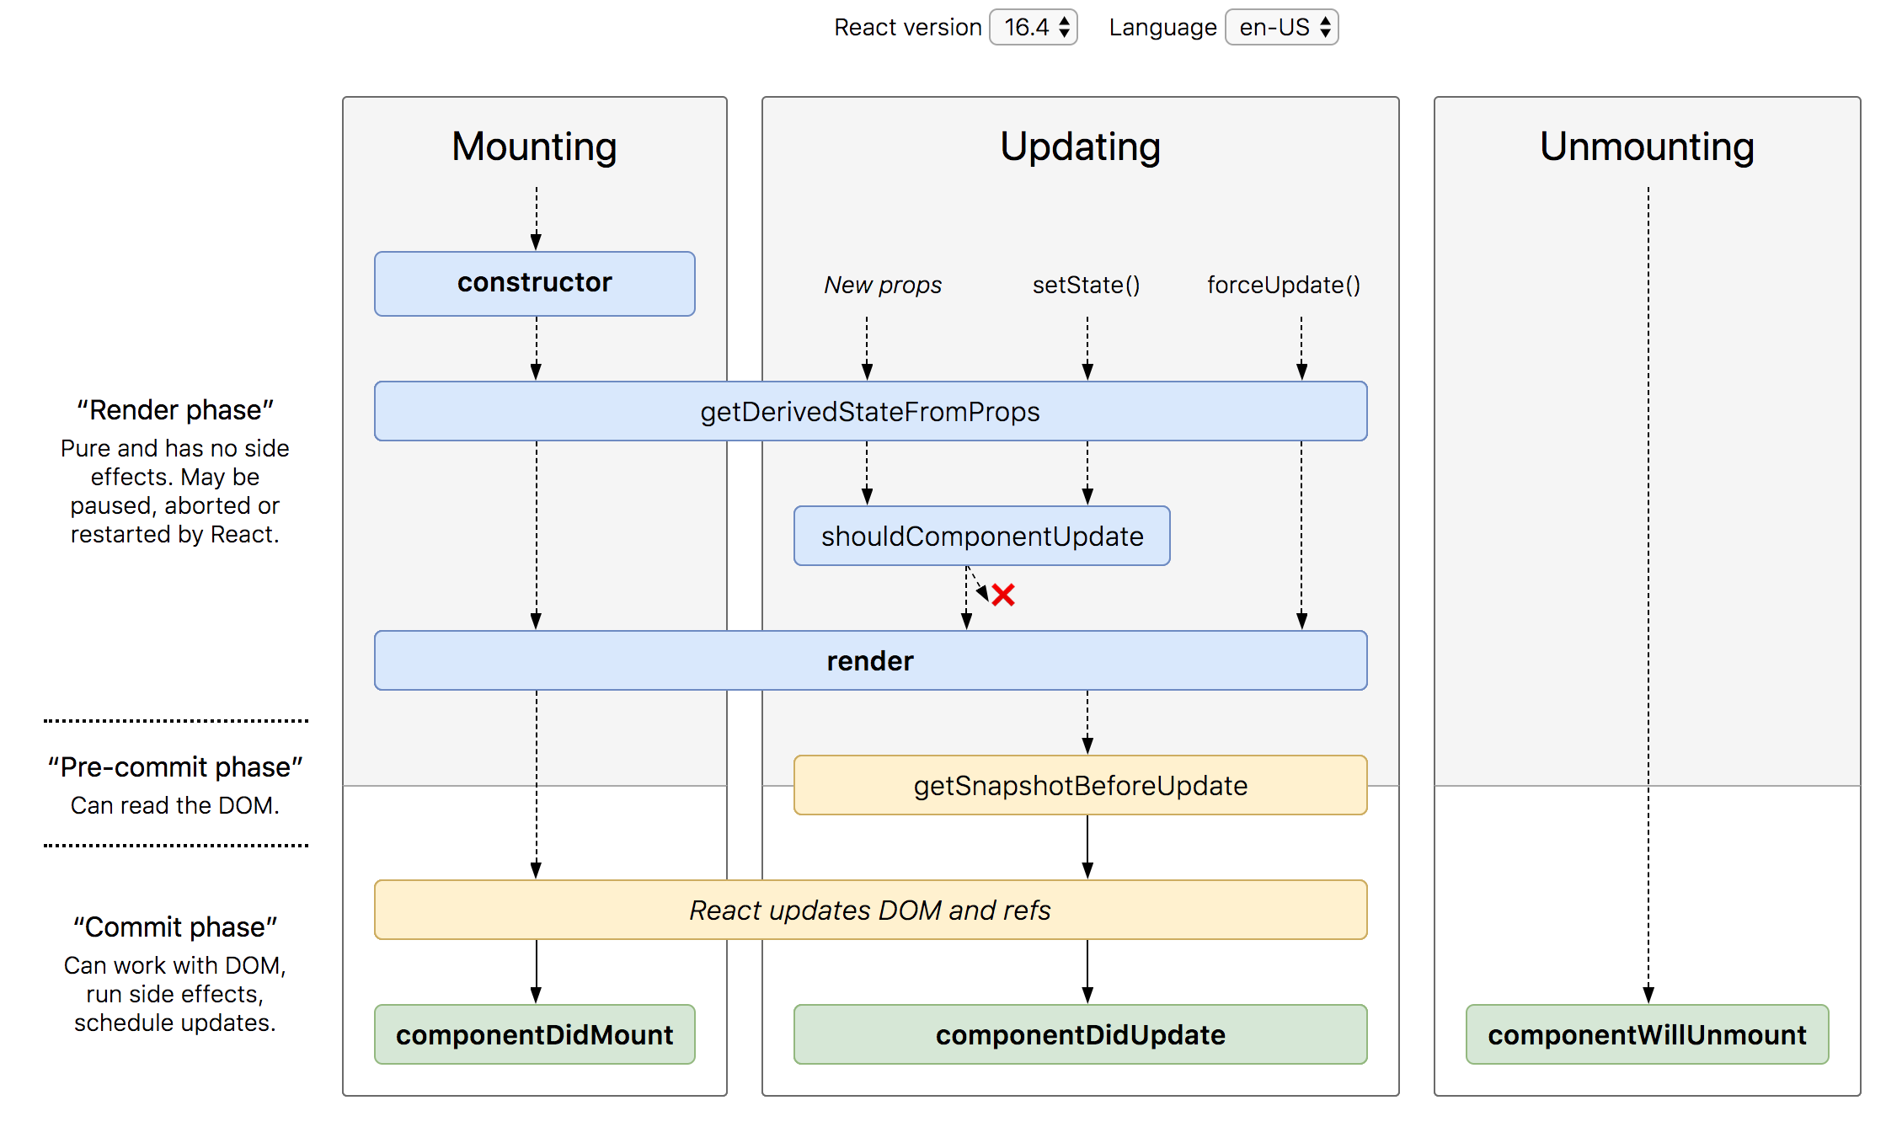
Lifecycle Methods

Slide 21
SyntheticEvent Object
Your event handlers will be passed instances of SyntheticEvent, a cross-browser wrapper around the browser’s native event.
It has the same interface as the browser’s native event, including stopPropagation() and preventDefault(), except the events work identically across all browsers.
The synthetic events are different from, and do not map directly to, the browser’s native events.

Slide 22
SyntheticEvent object attributes
boolean bubbles
boolean cancelable
DOMEventTarget currentTarget
boolean defaultPrevented
number eventPhase
boolean isTrusted
DOMEvent nativeEvent
void preventDefault()
boolean isDefaultPrevented()
void stopPropagation()
boolean isPropagationStopped()
void persist()
DOMEventTarget target
number timeStamp
string type

Slide 23
prop-types
React props, which stands for “properties,” are used to send data from one component to another.
If a component receives the wrong type of props, it can lead to bugs and unexpected errors in your app.
JavaScript doesn’t have a built-in type-checking solution.
React has an internal mechanism for props validation called propTypes.
npm i prop-types

Slide 24
Error Boundaries
If the errors are not handled, the react component will crash and show a blank UI.
Error boundaries are React components that catch JavaScript errors anywhere in their child component tree, log those errors, and display a fallback UI instead of the component tree that crashed.
Error boundaries catch errors during rendering, in lifecycle methods, and in constructors of the whole tree below them.
Error boundaries do not catch errors for:
Event handlers
Asynchronous code (e.g. setTimeout or requestAnimationFrame callbacks)
Server side rendering
Errors thrown in the error boundary itself (rather than its children)

Slide 25
Create an Error Boundary
A class component becomes an error boundary if it defines either (or both) of the lifecycle methods static getDerivedStateFromError() or componentDidCatch()
Use static getDerivedStateFromError() to render a fallback UI after an error has been thrown.
Use componentDidCatch() to log error information.
The granularity of error boundaries is up to you.
You may wrap top-level components to display a “Something went wrong” message to the user, just like how server-side frameworks often handle crashes.
You may also wrap individual components in an error boundary to protect them from crashing the rest of the application.

Slide 26
Hooks
Hooks are a new addition in React 16.8.
Hooks let you use state and other React features without writing a class.
Hooks are backwards-compatible
Built in Hooks
Basic Hooks
useState
useEffect
useContext
Additional Hooks
useReducer
useCallback
useMemo
useRef
useImperativeHandle
useLayoutEffect
useDebugValue

Slide 27
NODE SERVER
BROWSER
HTTP + URL (localhost:3000)
NAVIGATION
React Application
HTML Page + JS (React App)
NODE SERVER
EXPRESS JS
Web API
AJAX – localhost:8000/api/products
Database
JSON

Slide 28
Secure Application
When user clicks the Admin Link, we need to verify that we have a token in session storage, and if the token in not there in the session storage, redirect the request to login component. (SecuredRoute)
SecuredRoute uses Authenticator, isAuthenticated to check condition
If it is false, the request is redirected to Login Component
If it is true, the request is allowed for Admin Component
Logging and Token Management (Authenticator Service)
On Login Component, user must give username and password, which will be sent to API Server using Authenticator Service
If the username & password is correct, in the response, token will come from the Server
Received token will be stored in the session storage of the browser & isAuthenticated will be set to true
Reading and Attaching Token
Whenever the AJAX request is made for api, read and attach the token in request header using authenticator.getToken()

Slide 29
NODE SERVER
BROWSER
HTTP + URL (localhost:3000)
NAVIGATION
React Application
HTML Page + JS (React App)
HTTP + URL (AJAX) + Username & Password
NODE SERVER
EXPRESS JS
Web API
JSON with Token
{“token”:”___”}
AJAX – localhost:8000/api/products + Token
Database
JSON

Slide 30
HOC (Higher Order Components)
HOC is a pattern that emerges from React’s compositional nature.
A higher-order component (HOC) is an advanced technique in React for reusing component logic.
Component transforms props into UI, a higher-order component transforms a component into another component.
A higher-order component is a function that takes a component and returns a new component.

Slide 31
1
Will use the action types to identify an action which is dispatched, to do a specific operation on Store State
ACTION TYPE
Constants (string / symbol)
Will use action types to create an action object
3
R1
R2
R3
2
ACTION CREATOR
A function which creates and returns an Action object
ROOT REDUCER
REDUX STORE
Application State
4
ACTION OBJECT
Plain JavaScript Object
{
type: ActionType,
payload: data
}
CONTAINER COMPONENT
5
Dispatch
Action
Data Flow
PRESENTATIONAL COMPONENT (s)
6
mapDispatchToProps
mapStateToProps
Connection to Action Creator(s)
Connection to Reducer(s)

Slide 33
1
Will use the action types to identify an action which is dispatched, to do a specific operation on Store State
ACTION TYPE
Constants (string / symbol)
Will use action types to create an action object
Dispatch
Action
3
R1
R2
R3
2
ACTION CREATOR
A function which creates and returns an Action object
REDUX
THUNK
MIDDLEWARE
API SERVER
ROOT REDUCER
A function that takes parameter dispatch
REDUX STORE
Application State
4
ACTION OBJECT
Plain JavaScript Object
{
type: ActionType,
payload: data
}
CONTAINER COMPONENT
5
Dispatch
To Function
Data Flow
PRESENTATIONAL COMPONENT (s)
6
mapDispatchToProps
mapStateToProps
Connection to Action Creator(s)
Connection to Reducer(s)

Slide 34
React
Redux
Thunk , Saga, Observables
view-layer
state-layer
Side effects-layer

Slide 35
Contact Me
Manish Sharma | Gmail
Manish Sharma | WhatsApp
Manish Sharma | Facebook
Manish Sharma | LinkedIn

